Slide 1



Fundamentals of Nursing(1st Stage)
Administering Intra-dermal & Subcutaneous injections (practice)
Lecture 1
University of Basrah –College of Nursing – Fundamentals of Nursing Department

Slide 2
Introduction
An intra-dermal(I.D) injection: is the administration of a drug into the dermal layer of the skin just beneath the epidermis. This method of administration is frequently used for allergy testing and tuberculin screening.
University of Basrah –College of Nursing– Fundamentals of Nursing Department
2

Slide 3
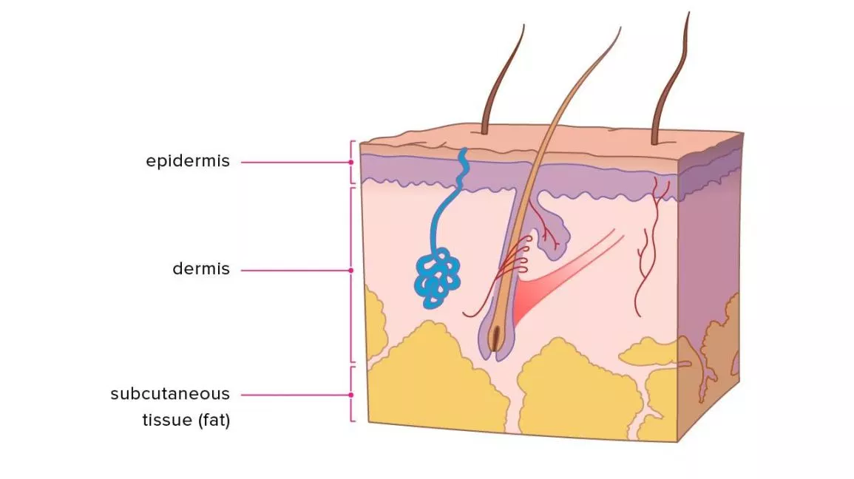

Slide 4
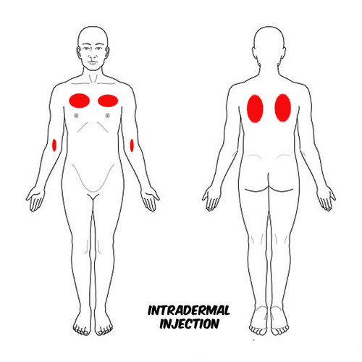
Common sites for intra-dermal injections
The inner aspect of forearm
Upper chest.
Upper back beneath the scapulae.
University of Basrah –College of Nursing– Fundamentals of Nursing Department
3

Slide 5
Notes
The angle of insertion for an intra-dermal injection is 5 to 15 degrees.
Only small amounts of medication 0.01 to 0.1 ml are injected intra-dermally. If a bleb does not appear, or if the site bleeds after needle withdrawal, the medication may have entered subcutaneous tissues. In this situation skin test results will not be valid.
University of Basrah –College of Nursing– Fundamentals of Nursing Department
4

Slide 6
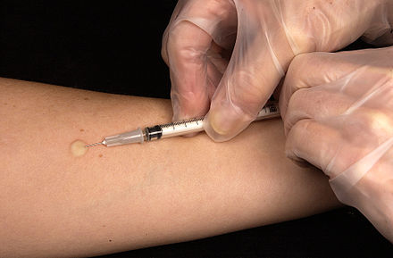
University of Basrah –College of Nursing– Fundamentals of Nursing Department
5

Slide 7
Equipment
Syringe: 1-mL TB syringe with preattached 25- or 27-gauge needle, 3/8- to 5/8 -inch
Small gauze pad
Alcohol swab
Vial or ampule of medication
Clean gloves
Medication administration record (MAR) or computer printout
Puncture-proof container
University of Basrah –College of Nursing– Fundamentals of Nursing Department
6

Slide 8
Nursing Diagnoses
Anxiety
Fear
Deficient knowledge regarding skin testing
Health-seeking behaviors regarding disease screening practices
University of Basrah –College of Nursing– Fundamentals of Nursing Department
7

Slide 9
Implementation
Prepare medications for one patient at a time using aseptic technique and avoiding distractions.
Close room curtain or door.
Discuss purpose of each medication, action, and possible adverse effects. Allow patient to ask any questions.
Perform hand hygiene and apply clean gloves. Select appropriate site. Note lesions or discolorations of skin. If possible, select site three to four finger widths below antecubital space and one hand width above wrist. If you cannot use forearm, inspect upper back.
Help patient to comfortable position. Have him or her extend elbow and support it and forearm on flat surface.
University of Basrah –College of Nursing– Fundamentals of Nursing Department
8

Slide 10
6. Clean site with antiseptic swab. Apply swab at center of site and rotate outward in circular direction for about 5cm (2 inches).
7. Hold swab or gauze between third and fourth fingers of nondominant hand.
8. Remove needle cap from needle by pulling it straight off.
9. Hold syringe between thumb and forefinger of dominant hand with bevel of needle pointing up.
10. Administer injection.
a ) With nondominant hand stretch skin over site with forefinger or thumb.
b) With needle almost against patient’s skin, insert it slowly at 5- to 15-degree angle until resistance is felt. Advance needle through epidermis to approximately 3 mm ( 1 8 inch) below skin surface. You will see bulge of needle tip through skin
University of Basrah –College of Nursing– Fundamentals of Nursing Department
9

Slide 11
c) While injecting medication, note that small bleb (approximately 6 mm [ 1 /4 inch]) resembling mosquito bite appears on skin surface.
e) After withdrawing needle, apply alcohol swab or gauze gently over site.
11. Discard uncapped needle or needle enclosed in safety shield and attached syringe in puncture- and leak-proof receptacle.
12. Remove gloves and perform hand hygiene.
13. Stay with patient for several minutes and observe for any allergic reactions.
University of Basrah –College of Nursing– Fundamentals of Nursing Department
10

Slide 12
Administering Subcutaneous injections
Subcutaneous ( S.C) injections: are administers into adipose tissue layer just below the epidermis and dermis. This tissue have few blood vessels, so drugs administered here have a slow, sustained rate of absorption into the capillaries. This route is used to administer drugs such as insulin and heparin.
University of Basrah –College of Nursing– Fundamentals of Nursing Department
11

Slide 13
Sites of injections
Outer aspect of the upper arms.
The abdomen from below the costal margins to the iliac crests.
The anterior aspects of the thighs.
Upper back
University of Basrah –College of Nursing– Fundamentals of Nursing Department
12

Slide 14
Notes
Subcutaneous injections are administered at a 45- to 90 – degree angle. Choose the angle of needle insertion based on the amount of subcutaneous tissue present and the length of the needle.
Generally, the shorter ,3/8'' needle is inserted at a 90– degree angle, 5/8 needle is inserted at a 45 – degree angle.
University of Basrah –College of Nursing– Fundamentals of Nursing Department
13

Slide 15
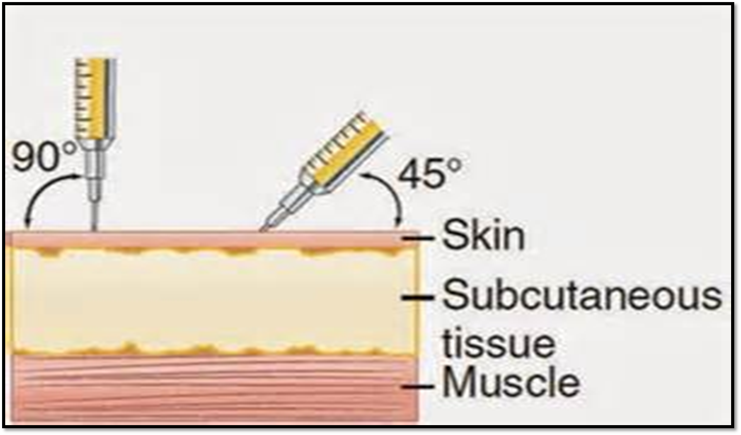
University of Basrah –College of Nursing– Fundamentals of Nursing Department
14

Slide 16
Recommendations differ regarding pinching or bunching of a skin fold for administration, pinching is advised for thinner patients and when a longer needle is used, to lift the adipose tissue away from underlying muscle and tissue. If pinching is used, once the needle is inserted, release the skin to avoid injecting into compressed tissue.
University of Basrah –College of Nursing– Fundamentals of Nursing Department
15

Slide 17
Aspiration or pulling back on the plunger to check that a blood vessel has been entered, is not necessary and has not proved to be a reliable indicator of needle placement.
Aspiration is definitely contraindicated with administration of heparin.
After withdrawing the needle, apply gentle pressure.
Massaging the site is not necessary and can damage underlying tissue and increase the absorption of the medication.
Avoid sites that are bruised, tender, hard, swollen, inflamed, or scarred. These conditions could affect absorption or cause discomfort and injury.
University of Basrah –College of Nursing– Fundamentals of Nursing Department
16

Slide 18
Absorption rates differ among the various sites. Injections in the abdomen are most rapidly absorped, ones in the arms are absorped some what more slowly, those in the thighs even more slowly, and those in the upper ventral or dorsogluteal areas have the slowest absorption.
University of Basrah –College of Nursing– Fundamentals of Nursing Department
17

Slide 19
Equipment
1-Medication administration record
2-Prescribed medication
3-Sterile syringe and needle
4-Antimicrobial swab
5-Small gauze square
6-Disposable gloves
7-Antiseptic solution
University of Basrah –College of Nursing– Fundamentals of Nursing Department
18

Slide 20
Nursing Diagnoses
Acute pain
Anxiety
Deficient knowledge regarding medication administration or drug therapy
Fear
Ineffective health maintenance
University of Basrah –College of Nursing– Fundamentals of Nursing Department
19

Slide 21
Implementation
Perform hand hygiene and prepare medication using aseptic technique.
Close room curtain or door.
Discuss purpose of each medication, action, and possible adverse effects.
Perform hand hygiene and apply clean gloves.
Select appropriate injection site. Inspect skin surface over sites for bruises, inflammation, or edema.
Help patient into comfortable position.
Clean site with antiseptic swab. Apply swab at center of site and rotate outward in circular direction for about 5 cm (2 inches).
Hold swab or gauze between third and fourth fingers of nondominant hand.
University of Basrah –College of Nursing– Fundamentals of Nursing Department
20

Slide 22
9. Remove needle cap or protective sheath by pulling it straight off.
10. Hold syringe between thumb and forefinger of dominant hand; hold as dart.
11. Administer injection:
For average-size patient, hold skin across injection site or pinch skin with nondominant hand.
Inject needle quickly and firmly at 45- to 90-degree angle . Release skin if pinched. Option: When using injection pen or giving heparin, continue to pinch skin while injecting medicine.
For obese patient pinch skin at site and inject needle at 90-degree angle below tissue fold.
After needle enters site, grasp lower end of syringe barrel with nondominant hand to stabilize it. Move dominant hand to end of plunger and slowly inject medication over several seconds. Avoid moving syringe.
University of Basrah –College of Nursing– Fundamentals of Nursing Department
21

Slide 23
e) Withdraw needle quickly while placing antiseptic swab or gauze gently over site.
12. Apply gentle pressure to site. Do not massage site.
13. Help patient to comfortable position.
14. Discard uncapped needle or needle enclosed in safety shield.
15. Remove gloves and perform hand hygiene.
University of Basrah –College of Nursing– Fundamentals of Nursing Department
22

Slide 24

University of Basrah –College of Nursing– Fundamentals of Nursing Department
23

